Slide 1
N BALA SARASWATHI
KEYLOGGER AND SECURITY
Final Project:
3/21/2024 Annual Review

Slide 2
KEYLOGGER AND SECURITY (Intro)
Definition : A keylogger is a type of malware that records every keystroke made on a computer, often without the user's knowledge or consent. This can be a serious security risk, as keyloggers can capture sensitive information such as passwords, credit card numbers, and personal information.
A keylogger, short for keystroke logger, is a type of surveillance technology used to monitor and record each keystroke typed on a computer's keyboard. This data is then stored locally or transmitted to a remote server.
Types of Keyloggers-
Software keyloggers: installed on a computer and records keystrokes.
Hardware keyloggers: physical devices that connect to a computer and records keystrokes.
Hybrid keyloggers: combination of software and hardware keyloggers
A keylogger, short for keystroke logger, is a type of surveillance technology used
3/21/2024 Annual Review

Slide 3


AGENDA
Problem statement
Project overview
Who are the end users?
Your Solution and its value Proportion
The wow in your solution
Modelling
Result
Project link
3/21/2024 Annual Review

Slide 4

PROBLEM STATEMENT
Keyloggers pose a significant threat to computer security and privacy.Current security measures may not be effective in detecting and preventing keylogger attacks.There is a need for a robust and efficient keylogger detection system.How can we design a reliable keylogger detection system to protect sensitive information?
Problem Definition: Keyloggers pose a significant threat to computer security and privacy.
Context: With the rise of remote work and online transactions, keylogger attacks are becoming more common.
Scope: This project focuses on designing and developing keylogger system and test personal computers.
Impact: If left unsolved, keylogger attacks can lead to identity theft, financial loss, and reputational damage.
Goals: Design a reliable keylogger System for analysis and detection system to protect sensitive information.
3/21/2024 Annual Review

Slide 5

PROJECT OVERVIEW
Title: Keylogger and Security.
Tagline: Protecting sensitive information from keylogger attacks.
Goal: Design a robust keylogger system for personal computers.
Objectives:
-Observe keylogger attacks in real-time.
-Prevent sensitive information from being compromised by analysing the real time scenerios.
-Balance detection accuracy with system performance.
Methodology:
-Research and analysis of keylogger attacks.
-Design and Development of a Keylogger system Script.
-Testing and evaluation of the system
This project aims to design and develop a Python-based keylogger script that detects and records keystrokes in real-time, posing a potential threat to computer security and privacy. The script will be capable of capturing sensitive information such as passwords and credit card numbers, highlighting the need for effective security measures. The goal is to demonstrate the risks associated with keylogger attacks and promote awareness about computer security. The script will be tested on various platforms to evaluate its efficacy and potential limitations."
3/21/2024 Annual Review

Slide 6


WHO ARE THE END USERS?
The end users of this keylogger program could be individuals or organizations looking to monitor and track keyboard activity for security or monitoring purposes. However, it is essential to use such tools responsibly and ethically.
User Categories:
Parents monitoring their children's online activities .
Employers monitoring employees' computer usage.
Cybersecurity researchers studying keylogger behavior.
Individuals monitoring their own computer activity for security purposes.
User Roles:
Home users.
Business owners.
IT professionals.
Researchers
3/21/2024 Annual Review

Slide 7

YOUR SOLUTION AND ITS VALUE PROPOSITION
Solution:-
Product/System Name: Keylogger System.
Description:
A software-based keylogger that records and tracks keystrokes in real-time.
Key Features:
Advanced filtering and search capabilities .
User-friendly interface .
Multi-device support .
Real-time keystroke recording.
Technology/Platform:
Developed in Python, compatible with Windows, Mac, and Linux
3/21/2024 Annual Review

Slide 8
Value Proposition:-
Problem Statement:
Parents and employers need a reliable and easy-to-use tool to monitor computer activity and ensure security.
Solution Benefits:
Improved computer security.
Enhanced monitoring and tracking capabilities .
Increased productivity .
Peace of mind for parents and employers.
Unique Selling Points (USPs):
Advanced features .
Ease of use .
Cost-effective .
Real-time monitoring .
Competitive Advantage:
Our Keylogger System offers a comprehensive monitoring solution with advanced features and ease of use, making it the go-to choice for parents and employers.

Slide 9

THE WOW IN YOUR SOLUTION
Wow Factor-
Breakthrough Technology: Our Keylogger System utilizes advanced algorithms and machine learning to detect and record keystrokes with unprecedented accuracy and speed.
Real-Time Insights: Get instant access to keystroke data, allowing you to respond quickly to potential security threats or monitor activity as it happens.
Advanced Analytics: Our system provides in-depth analysis and visualization of keystroke data, helping you identify trends, patterns, and anomalies.
Ease of Use: Intuitive interface and user-friendly design make it easy to deploy, configure, and use our Keylogger System, even for non-technical users.
Scalability: Our solution is designed to handle large volumes of data and scale with your needs, making it perfect for large enterprises or small businesses alike.
Customization: Tailor our Keylogger System to fit your specific needs, with customizable alerts, filters, and reports.
Unparalleled Support: Our dedicated team provides top-notch support, ensuring you get the most out of our solution.
3/21/2024 Annual Review
9

Slide 10
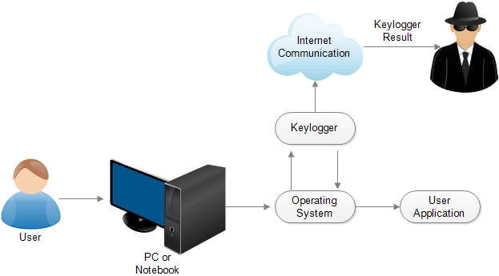
MODELLING
The keylogger program is designed to listen for keypress and release events using the pynput library. It categorizes the keys as pressed, held, or released and saves this information in both a text file ('key_log.txt') and a JSON file ('key_log.json'). The GUI built with Tkinter includes buttons to start and stop the keylogger, along with a label to display the program's status.
3/21/2024 Annual Review
10

Slide 11
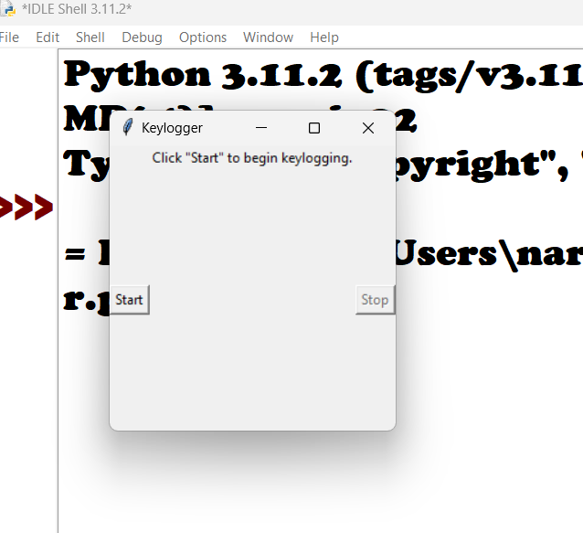
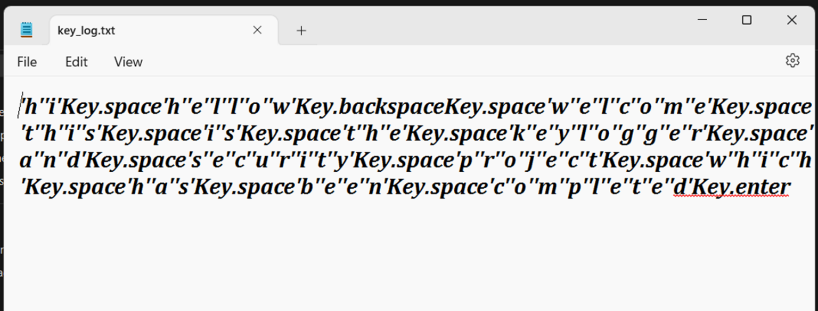
RESULTS
output:
3/21/2024 Annual Review
11

Slide 12
Project link
https://github.com/Govardhan2302/APSSDC-Key-logger-Project.git

